Slide 1

‘He has shown you, O mortal, what is good. And what does the Lord require of you? To act justly and to love mercy and to walk humbly with your God.’
Micah 6:8

Slide 2
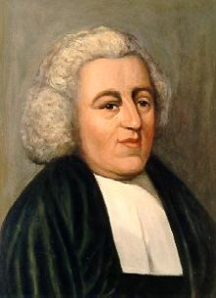
‘There is hardly any one passage in the Bible more generally misunderstood.’
John Newton

Slide 3
‘Is not the root of salvation, but the fruit of it’

Slide 4
God's Desire for All to be Saved - 1 Timothy 2:4
‘Who wants all people to be saved and to come to a knowledge of the truth.’
Patience and Repentance - 2 Peter 3:9b
‘…not wanting anyone to perish, but everyone to come to repentance.’
Jesus as the Only Way - John 14:6
‘Jesus answered, “I am the way and the truth and the life. No one comes to the Father except through me.”’

Slide 5
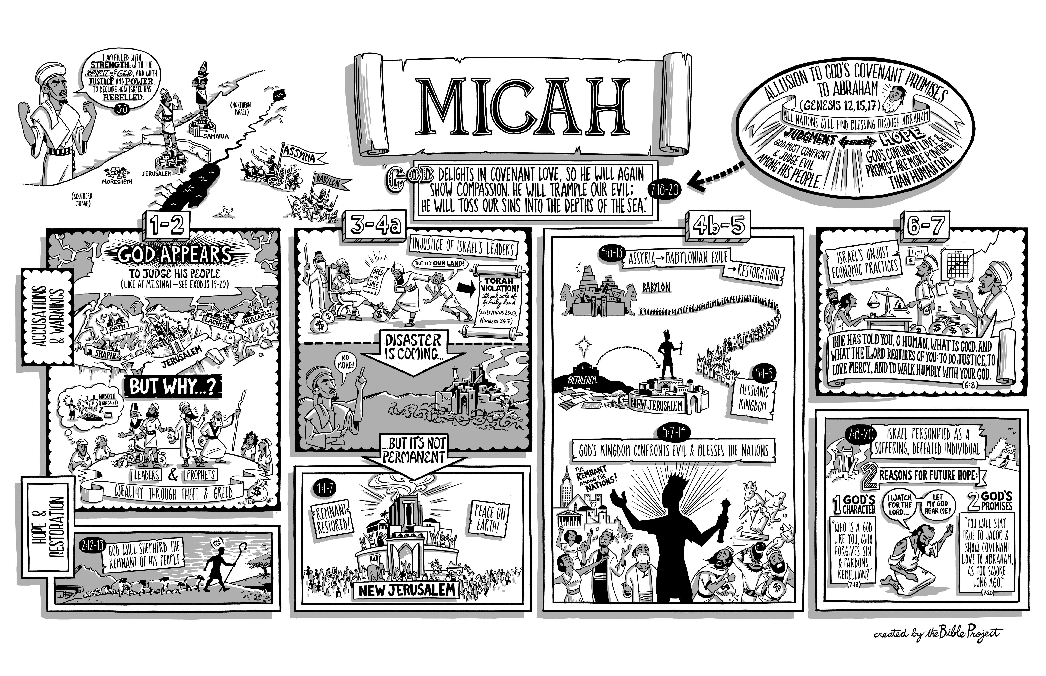

Slide 6
Listen to what the Lord says:
Stand up, plead my case before the mountains;
let the hills hear what you have to say.
Hear, you mountains, the Lord’s accusation;
listen, you everlasting foundations of the earth.
For the Lord has a case against his people;
he is lodging a charge against Israel.
Micah 6:1-2

Slide 7
My people, what have I done to you?
How have I burdened you? Answer me.
Micah 6:3
How have I let you down?

Slide 8
I brought you up out of Egypt and redeemed you from the land of slavery.
I sent Moses to lead you, also Aaron and Miriam.
My people, remember what Balak king of Moab plotted and what Balaam son of Beor answered.
Remember your journey from Shittim to Gilgal, that you may know the righteous acts of the Lord.
Micah 6:4-5

Slide 9
Q1: ‘With what shall I come before the Lord and bow down before the exalted God?’
Q2: ‘Shall I come before him with burnt offerings, with calves a year old?’
Q3: ‘Will the Lord be pleased with thousands of rams, with ten thousand rivers of olive oil?’
Q4: ‘Shall I offer my firstborn for my transgression, the fruit of my body for the sin of my soul?’
Micah 6:6-7

Slide 10
He has shown you, O mortal, what is good.
And what does the Lord require of you?
Speaking to the already revealed revelation of God
God’s Word reveals God’s Will to us
Any disobedience on our parts has nothing to do with revelation of God but our own willingness

Slide 11
He has shown you, O mortal, what is good.
And what does the Lord require of you?
Simply means a human being - someone living but subject to death
Micah’s words are addressed to all of us

Slide 12
He has shown you, O mortal, what is good.
And what does the Lord require of you?
God’s commands have a rich and full meaning
God’s commands come out of his love for us

Slide 13
He has shown you, O mortal, what is good.
And what does the Lord require of you?
‘If you keep my commands, you will remain in my love, just as I have kept my Father’s commands and remain in his love. I have told you this so that my joy may be in you and that your joy may be complete.’
John 15:10–11

Slide 14
He has shown you, O mortal, what is good.
And what does the Lord require of you?
God does not have unspoken expectations
We have an incredible ability to bring joy to the heart of God through our obedience

Slide 15
To act justly and to love mercy
and to walk humbly with your God
The existence of these aspects in our lives
Do they mark our lives as believers?

Slide 16
To act justly and to love mercy
and to walk humbly with your God
Mishpat - What is right, determining what is right and wrong, giving people what is theirs, and carrying out right judgement

Slide 17
To act justly and to love mercy
and to walk humbly with your God
‘Do not judge, or you too will be judged’ (v1)
‘Why do you look at the speck of sawdust in your brother’s eye and pay no attention to the plank in your own eye?’ (v3)
‘You hypocrite, first take the plank out of your own eye, and then you will see clearly to remove the speck from your brother’s eye’ (v5)
Matthew 7:1,3 & 5

Slide 18
To act justly and to love mercy
and to walk humbly with your God
It’s immensely practical
It’s doing what is right in the eyes of God
When we step up to do justice, there is a joy in it (Proverbs 21:15)

Slide 19
To act justly and to love mercy
and to walk humbly with your God
We should have a deep affection for mercy
A genuine affection for kindness and compassion

Slide 20
To act justly and to love mercy
and to walk humbly with your God
‘It is not the healthy who need a doctor, but the sick... I desire mercy, not sacrifice’
Matthew 9:12-13

Slide 21
To act justly and to love mercy
and to walk humbly with your God
If we walk humbly with our God, then by the closeness to his presence, we will be compelled to act justly, to love mercy
Our relationship with God must be personal - we each need to walk humbly with our God

Slide 22
To act justly and to love mercy
and to walk humbly with your God
‘He must become greater; I must become less’
John 3:30

Slide 23
To act justly and to love mercy
and to walk humbly with your God
‘God opposes the proud but shows favor to the humble. Humble yourselves, therefore, under God’s mighty hand, that he may lift you up in due time.’
1 Peter 5:5b-6

Slide 24
What is lacking in me?
Actions: Am I acting justly?
Affections: Am I loving mercy?
Attitude: Am I walking humbly with God?

