Slide 1
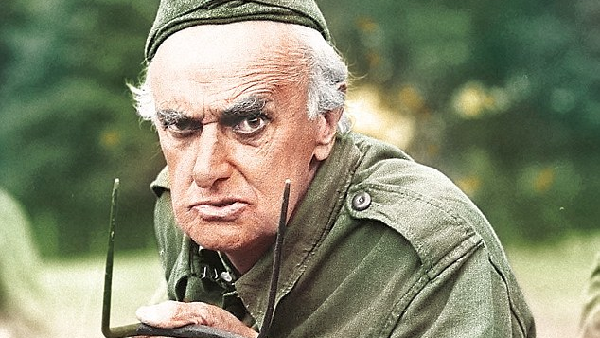
“We’re Doomed”

Slide 2
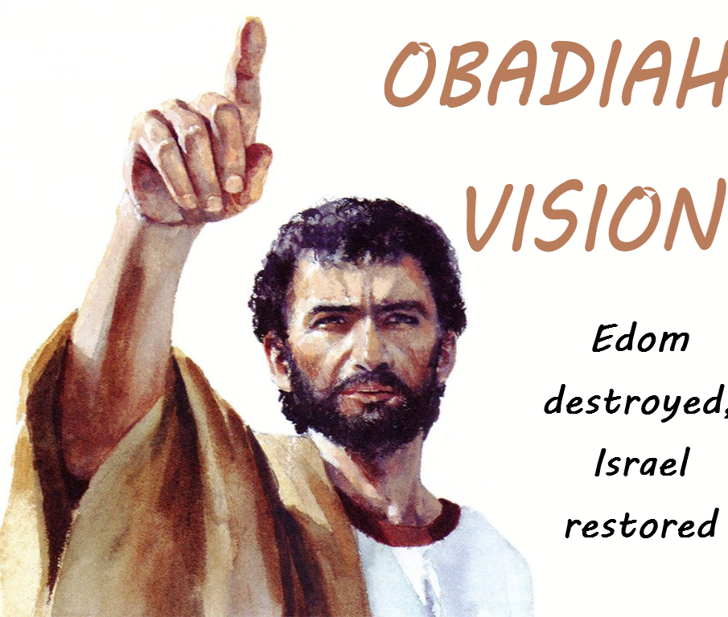
“Edom:
You’re Doomed”

Slide 3
Obadiah is rebuking sin.

Slide 4
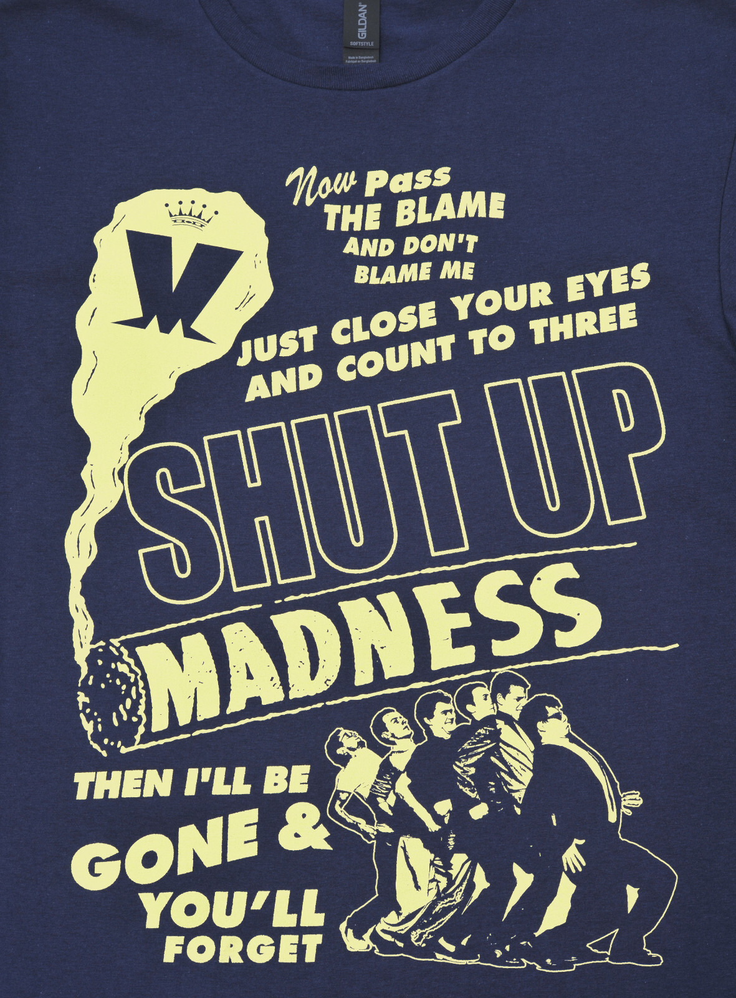
We must not ‘stand aloof’ to sin and injustice

Slide 5

You reap what you sow

Slide 6

Pride comes before a fall
Proverbs 16:18

Slide 7
The war against sin was won on the cross, but the battle against the flesh continues

Slide 8
The Kingdom will be the Lord’s

