Slide 1
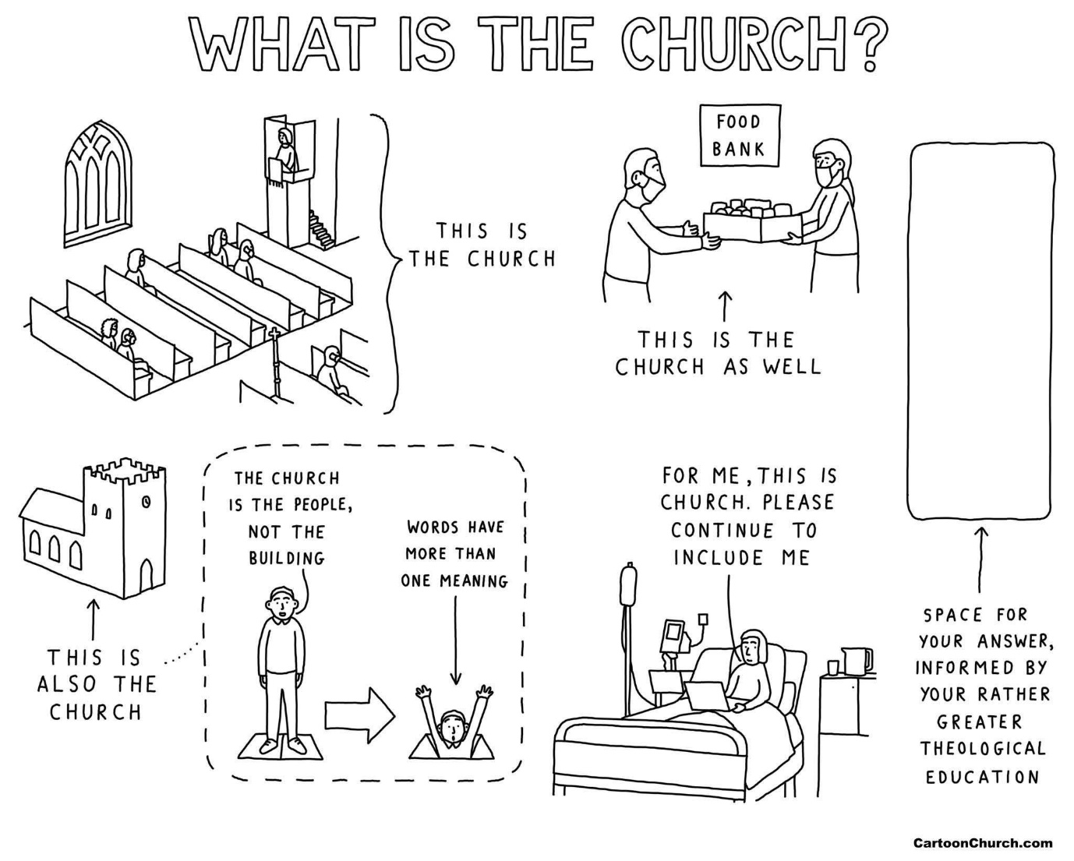

Slide 2
‘How good and pleasant it is when God’s people live together in unity.’ Psalm 133:1

Slide 3
‘It is not good for the man to be alone’

Slide 4

Closer with each other. Closer to God.

Slide 5

Church with a purpose

