Slide 1
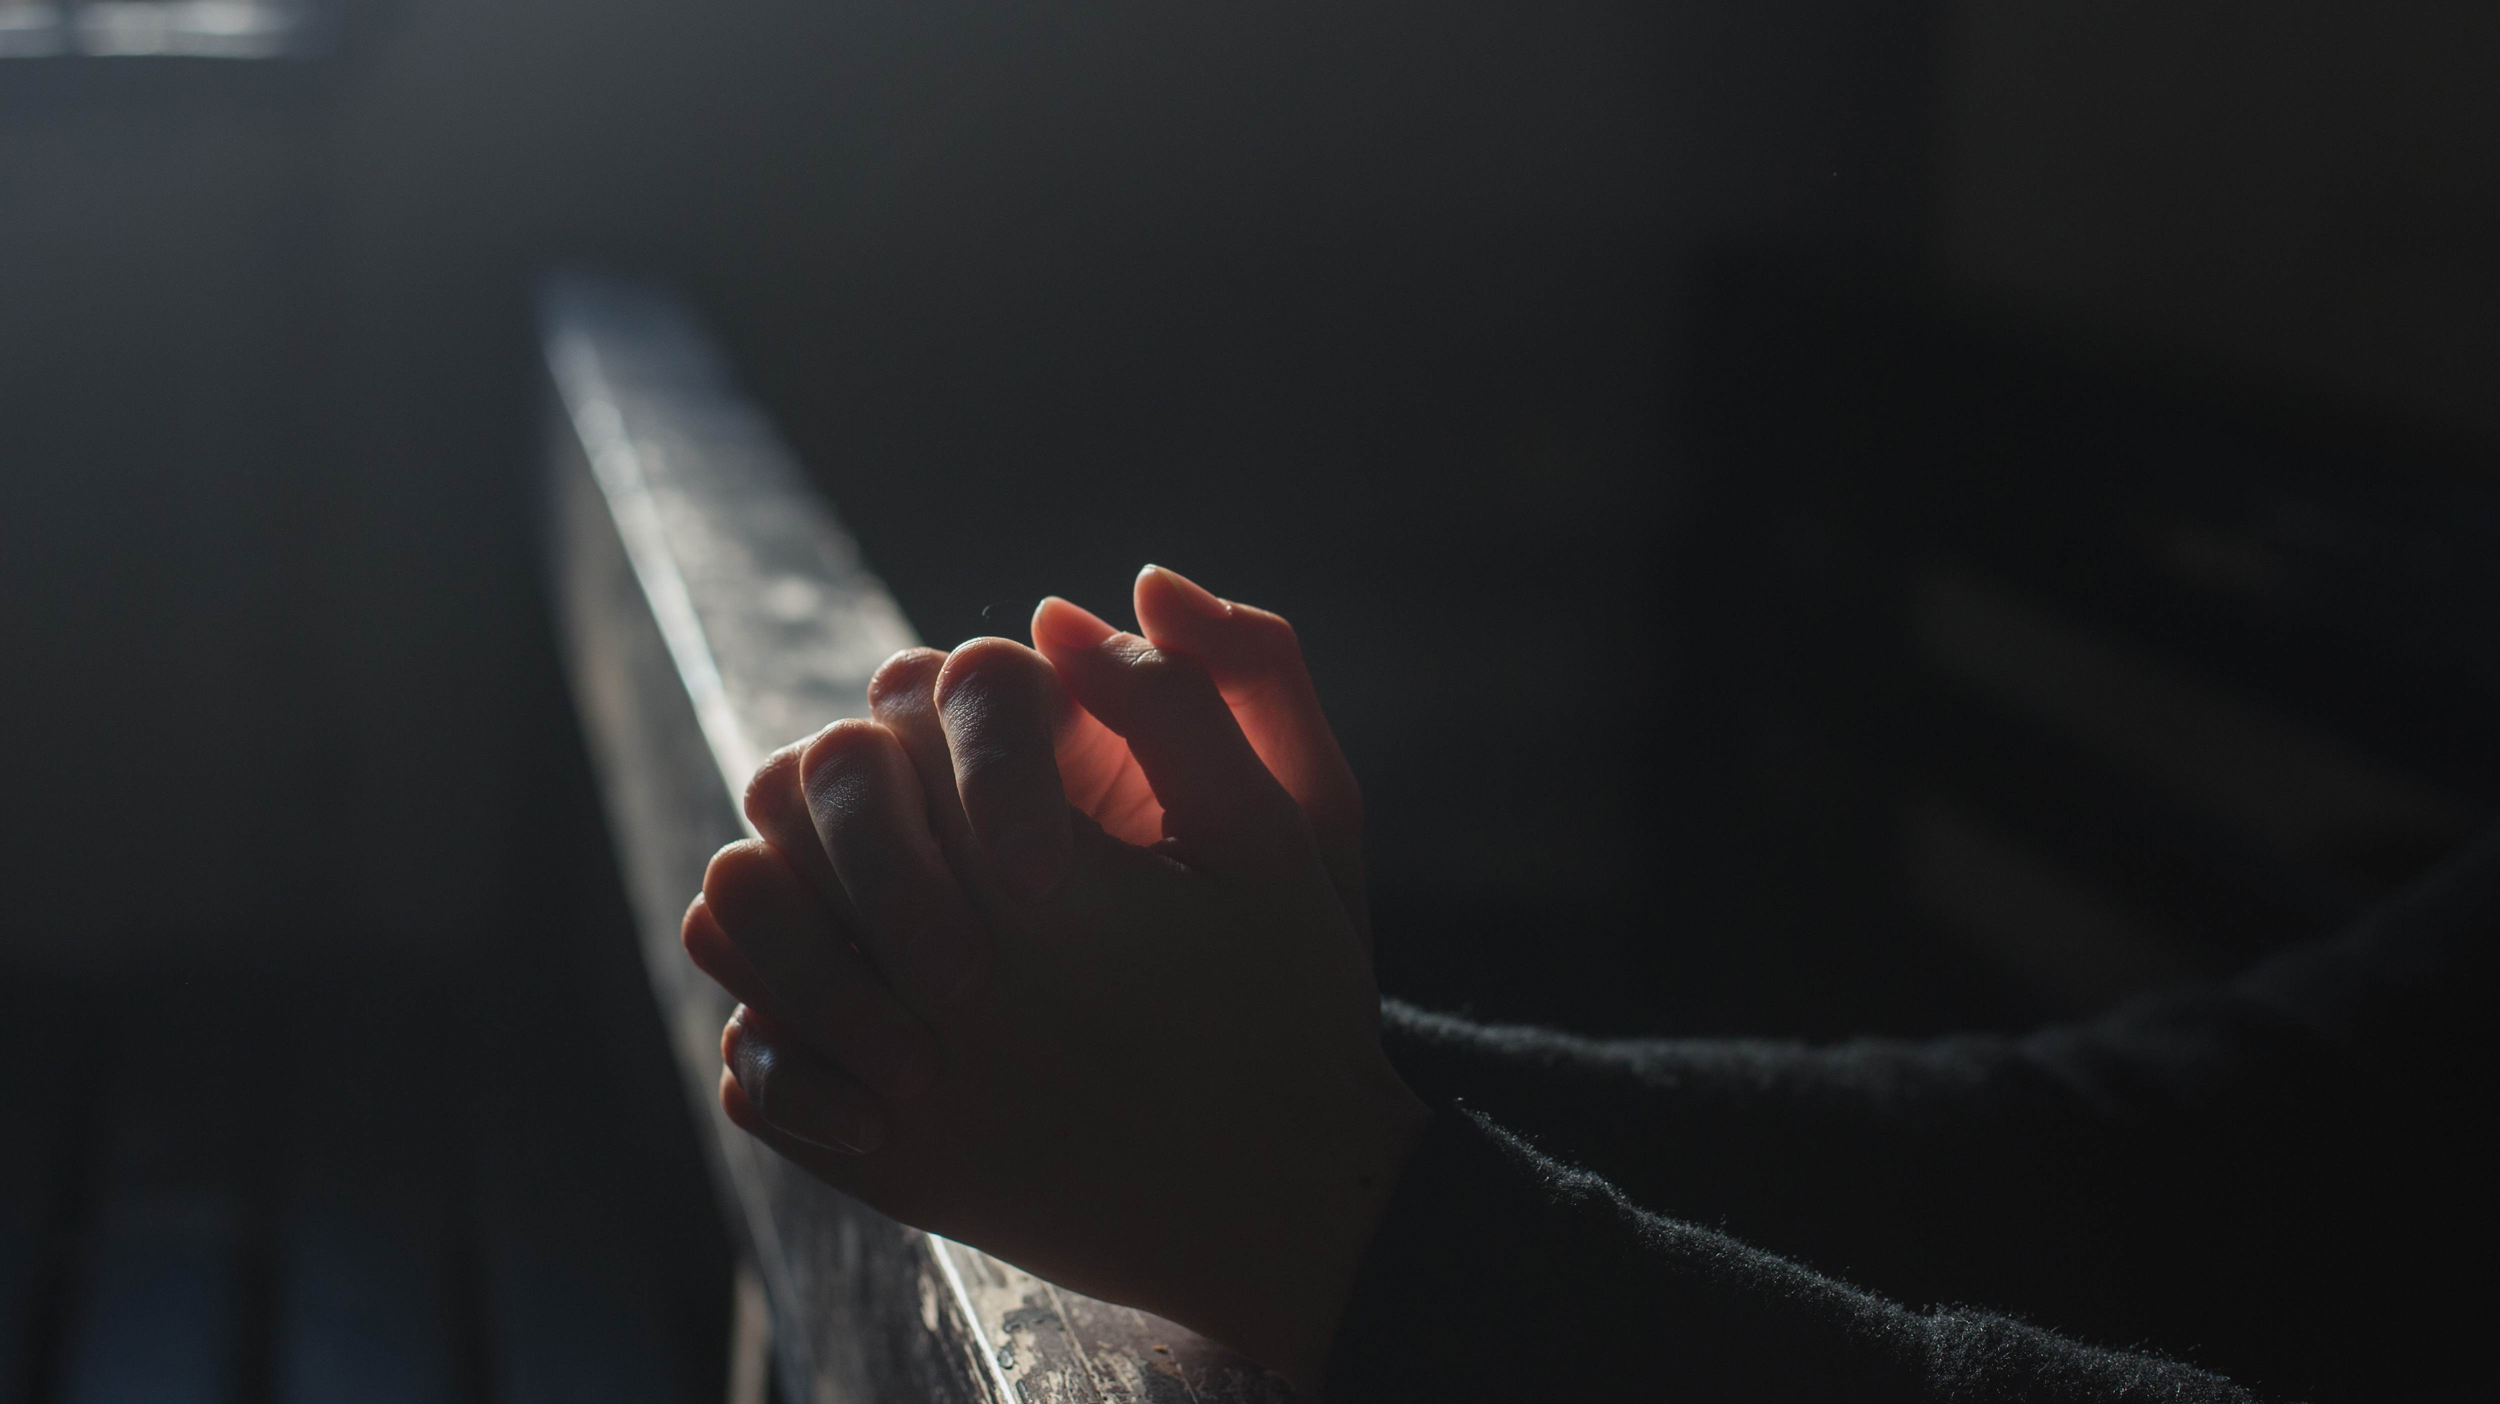
Prayer

Slide 2
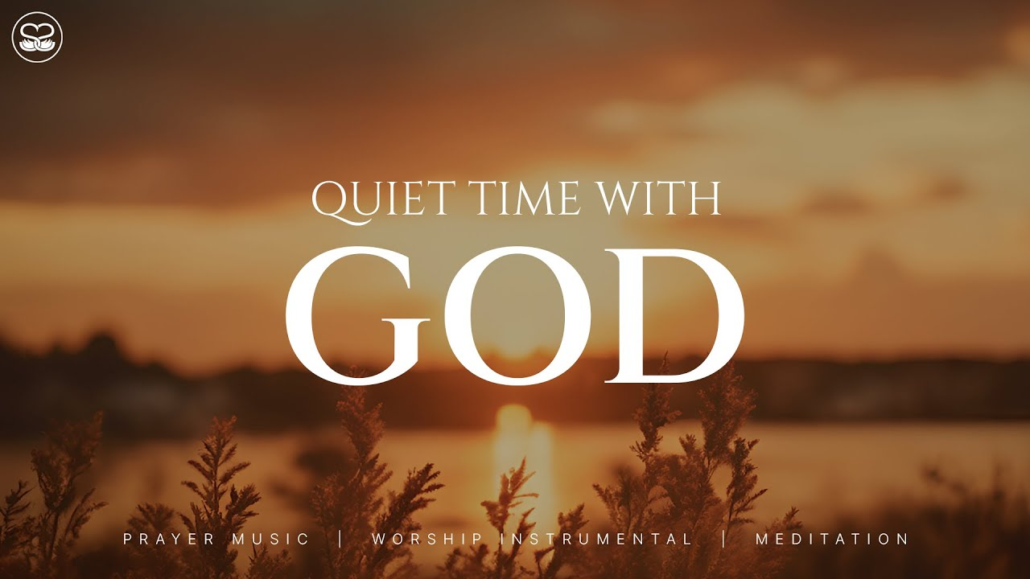
Relationships grow in the quiet moments…

Slide 3
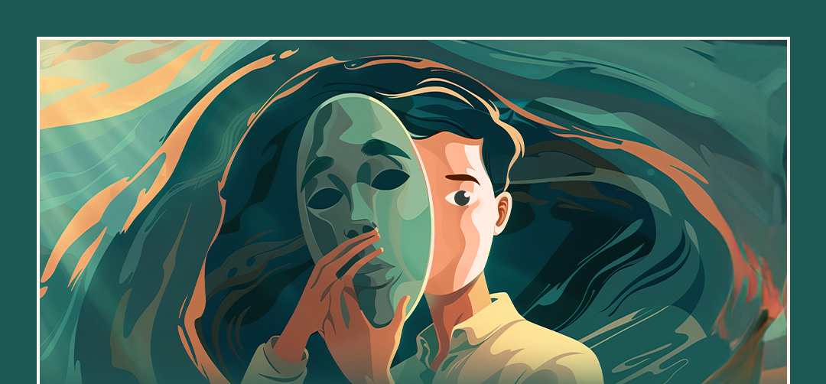
Authentic Prayer

Slide 4

Prayer is not a performance

Slide 5
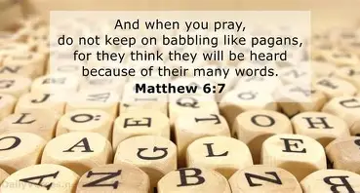

Slide 6

Prayer is Rewarding

Slide 7
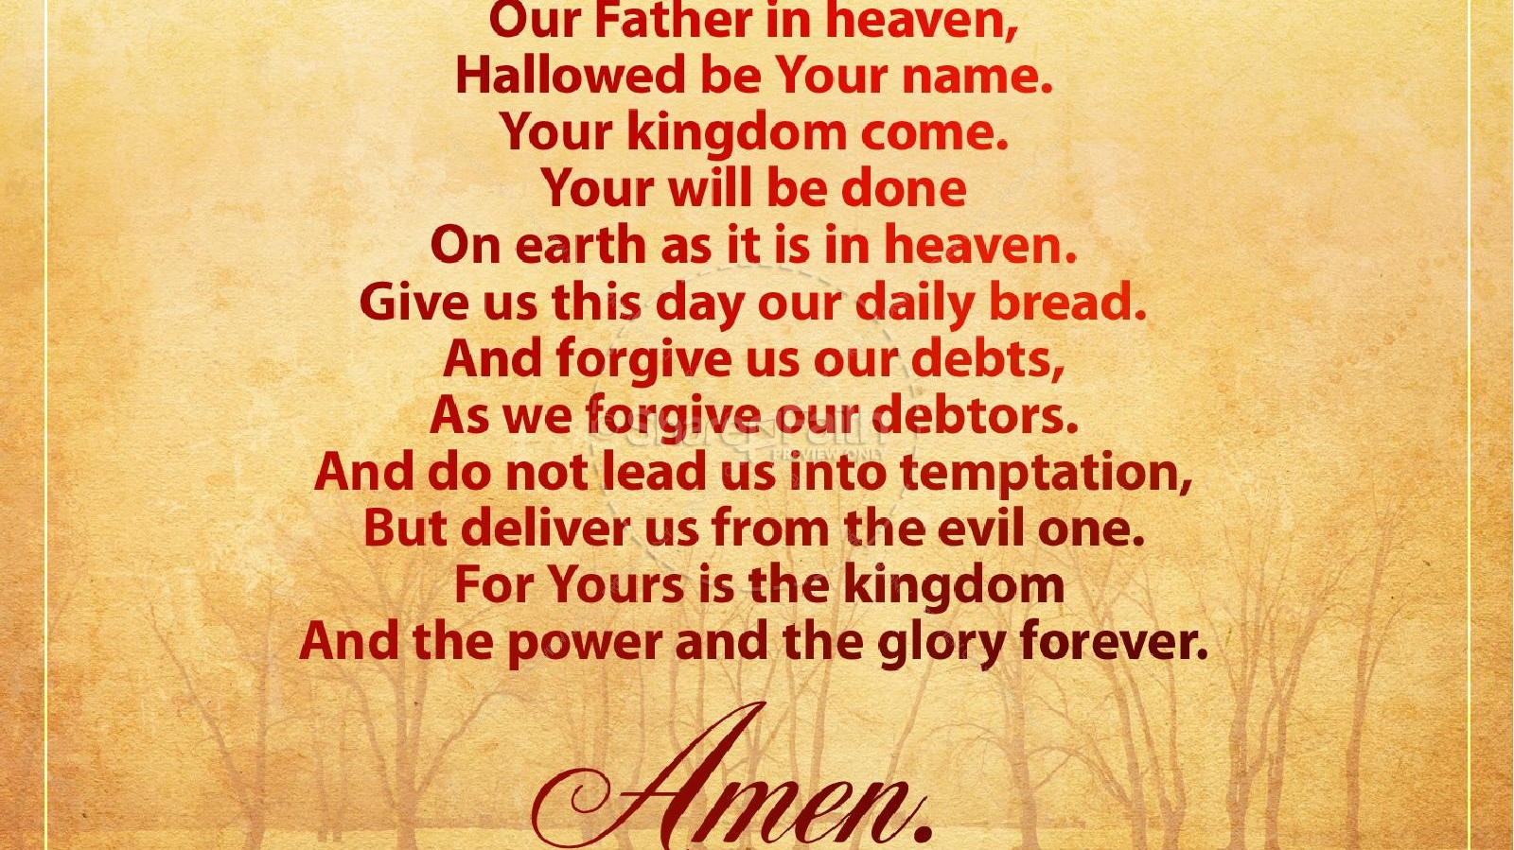

Slide 8
Your Will be Done

Slide 9
