Slide 1

Romans 5
‘Christ died for the ungodly’

Slide 2
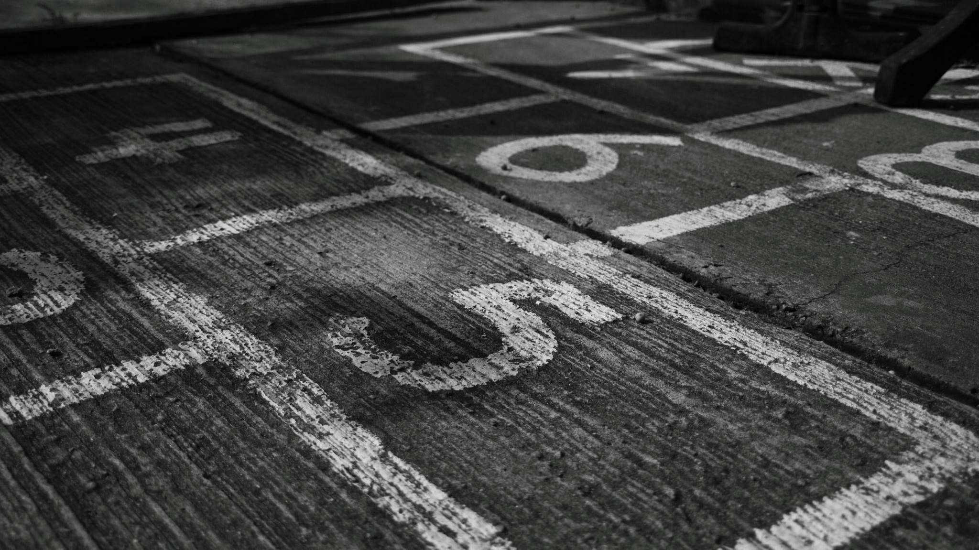
New Standing
Verse 1-5

Slide 3

New Rescue
Verses 6-11

Slide 4

New Reign
Verses 12-21

Slide 5
Blinded by your Grace

