Slide 1
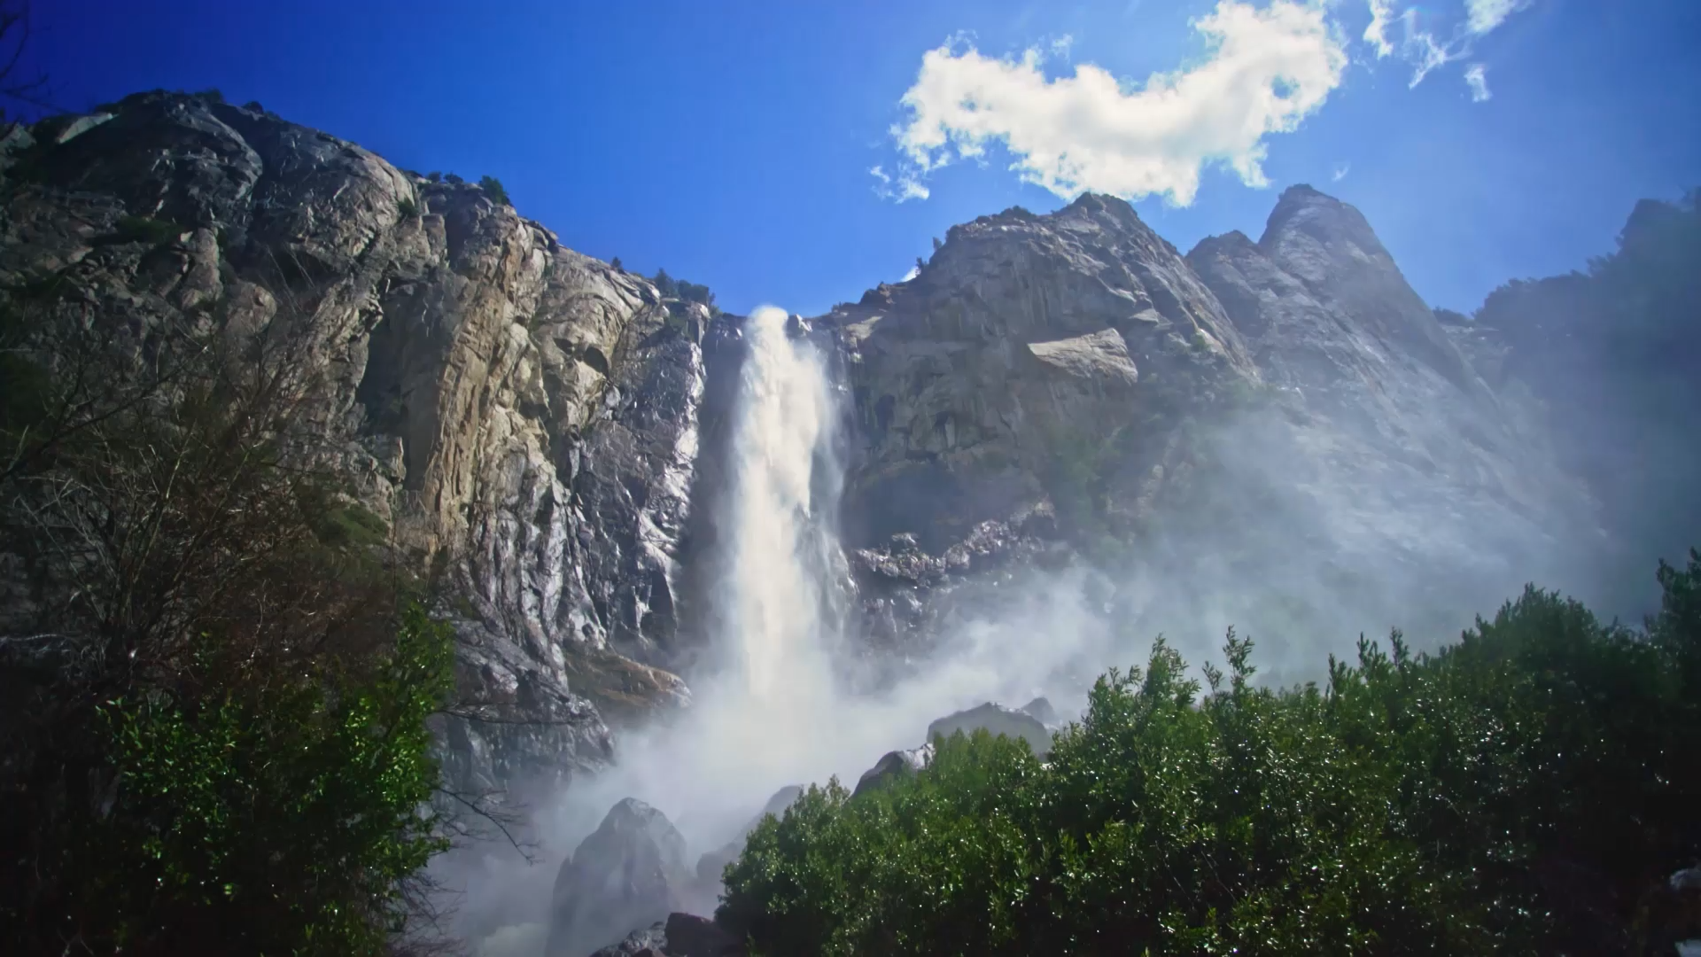
Hope in the Valley

Slide 2
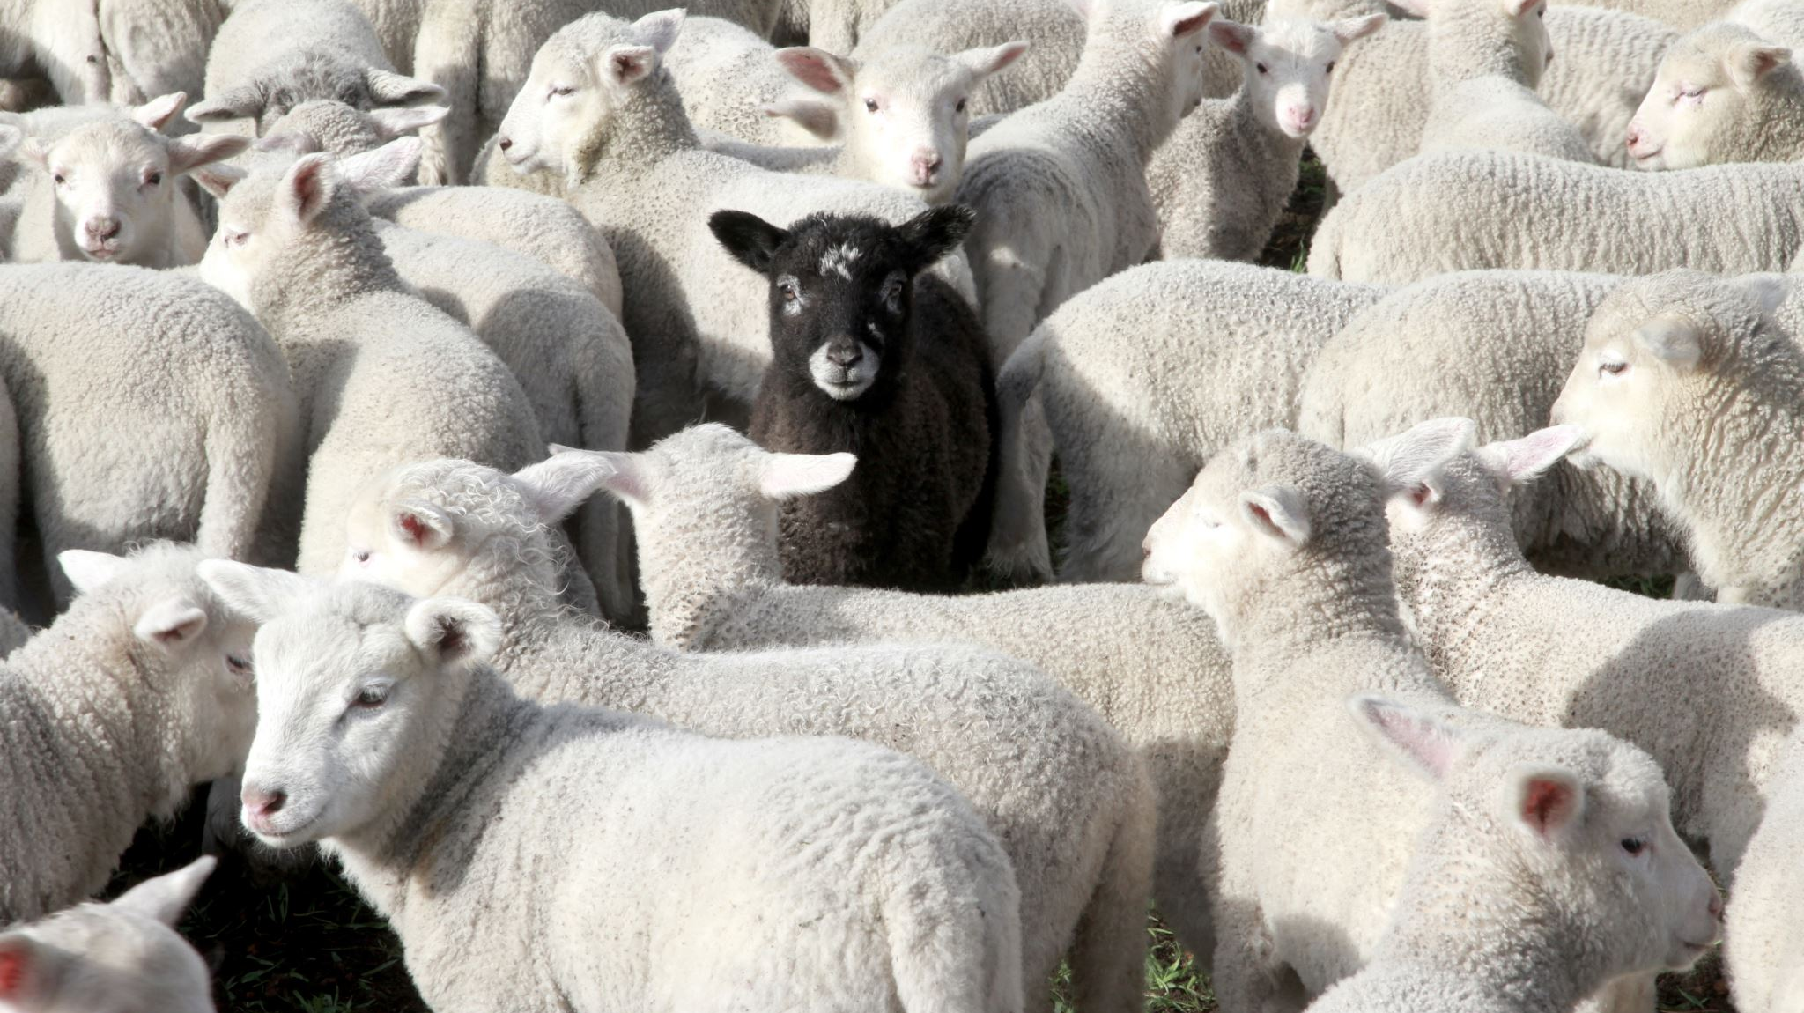
The Lord is my Shepherd

Slide 3
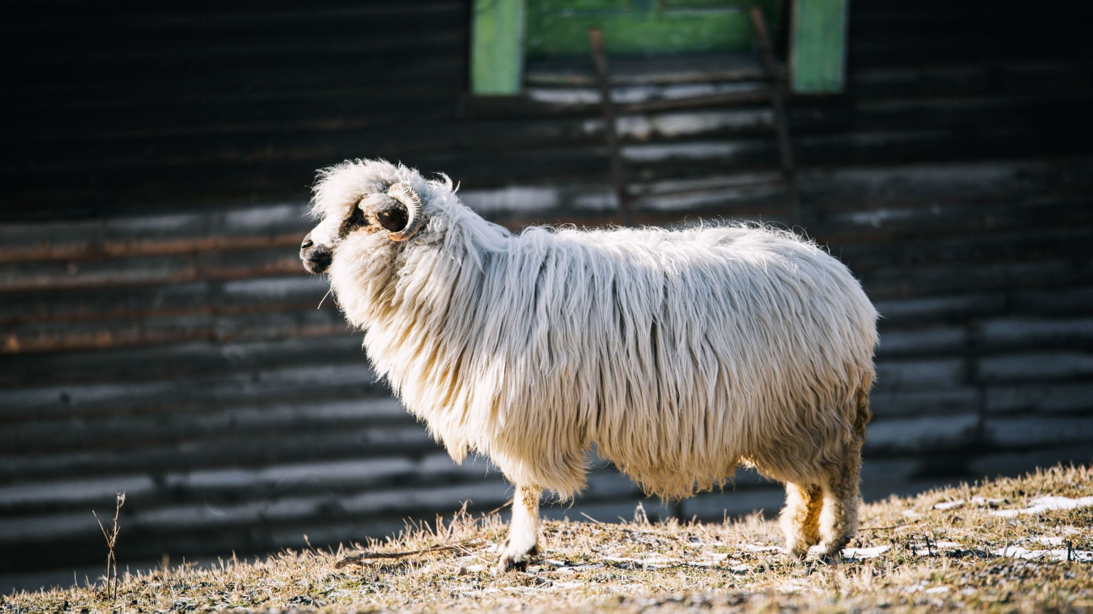
“I am the Good Shepherd”

Slide 4
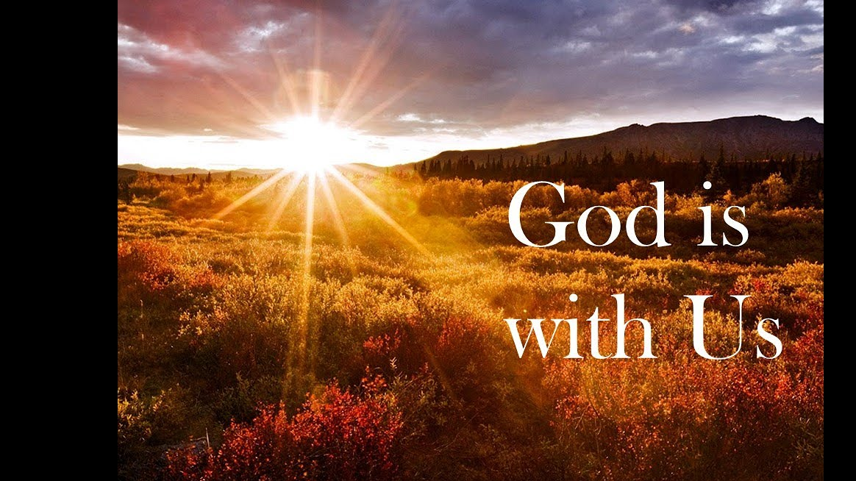

Slide 5


Slide 6
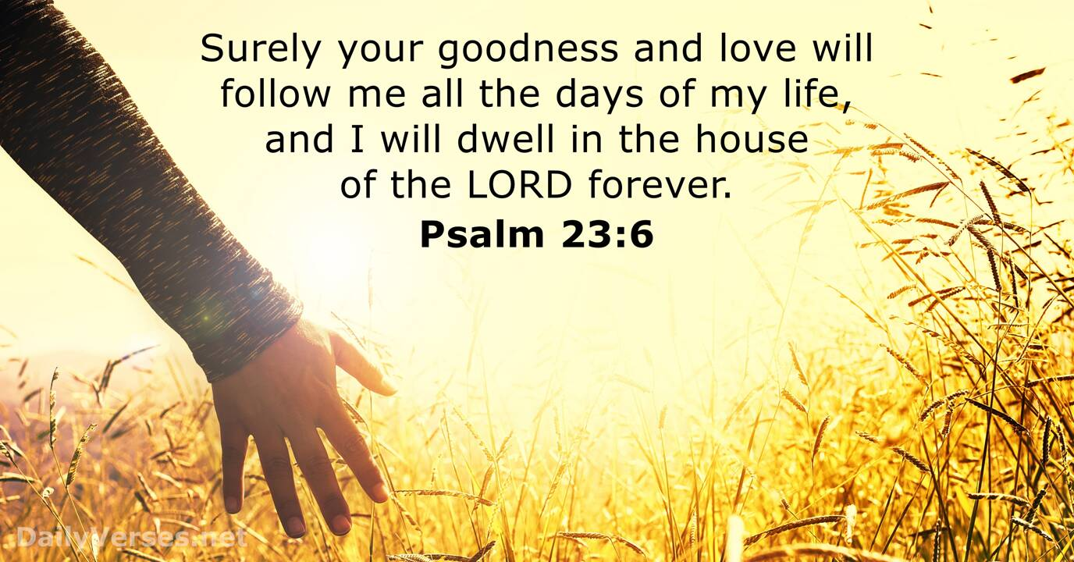

Slide 7
Hope in the Valley

