Slide 1

Hope in His Strength

Slide 2
God is Here

Slide 3
God’s Hope is Eternal

Slide 4

God is the Source of Power

Slide 5

Hope, Strength and Power Comes from God

Slide 6

Overwhelming Hope

Slide 7
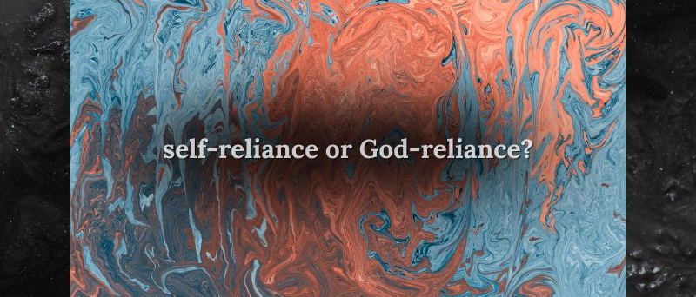
“God is not criticizing youthfulness; rather, He is exposing self-reliance. Even the best-conditioned believer eventually reaches the end of his resources.”

Slide 8

Fully
Rely
On
God

