Slide 1
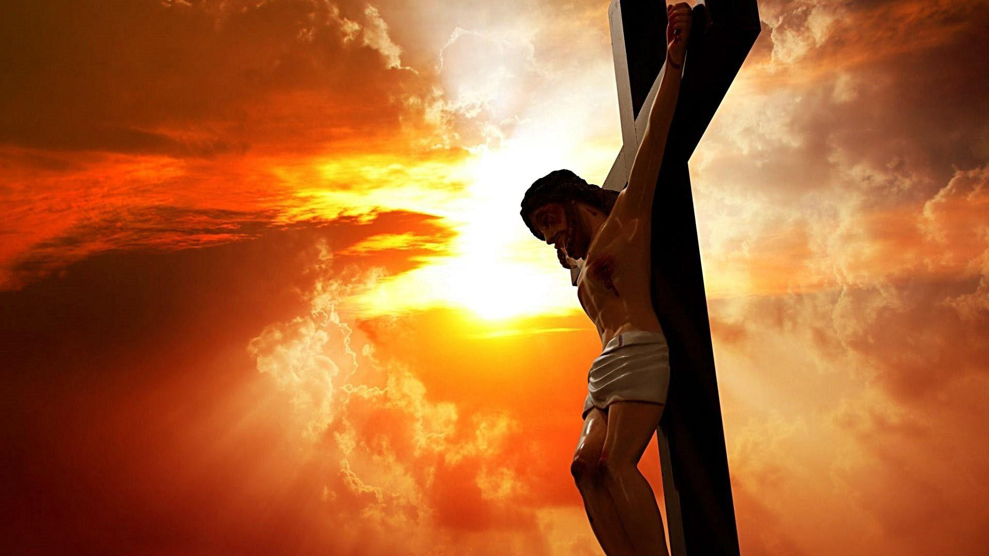
Hated

Slide 2
Weak

Slide 3
Son of Man

