Slide 1


Slide 2


Slide 3


Slide 4


Slide 5


Slide 6


Slide 7
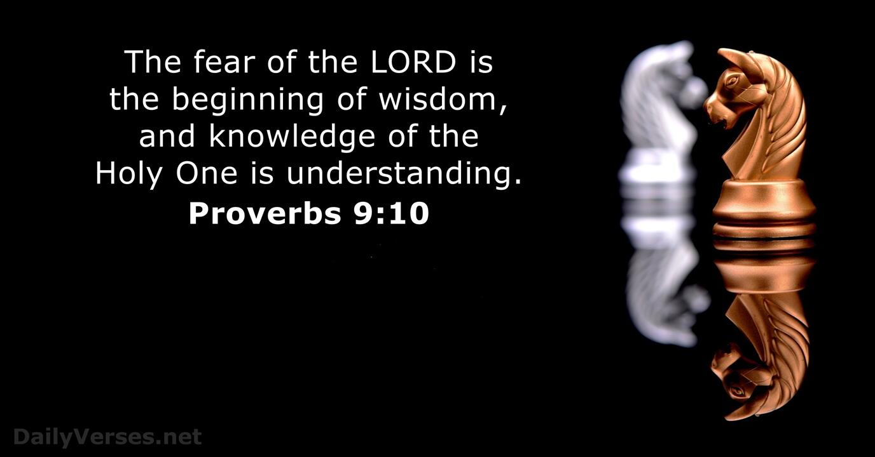

Slide 8


Slide 9

Pure, peace loving, considerate, submissive, full of mercy and good fruit, impartial and sincere

