Slide 1

You can’t take it with you

Slide 2



Slide 3

Our Value is found in Jesus

Slide 4
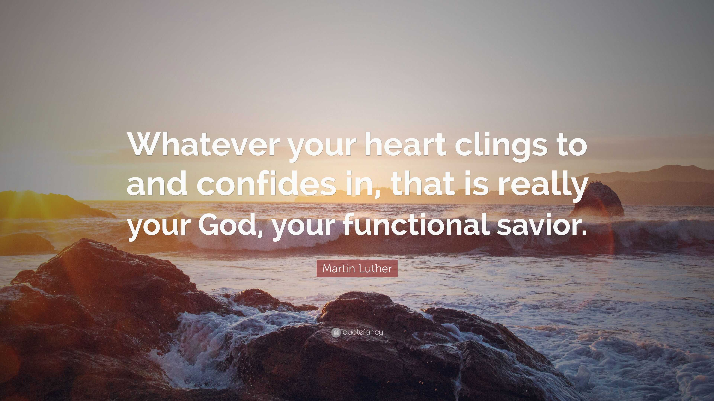

Slide 5


Slide 6
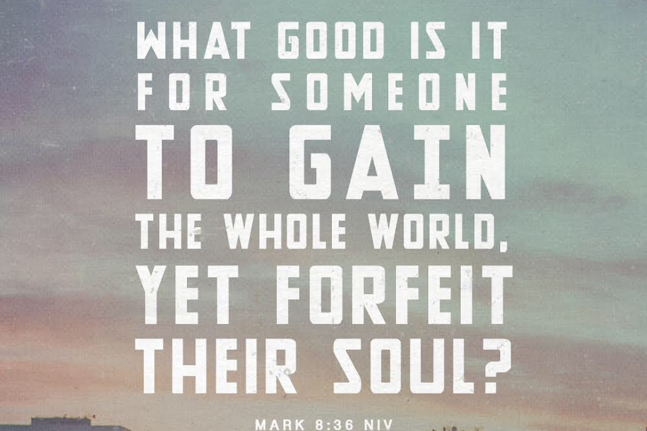

Slide 7
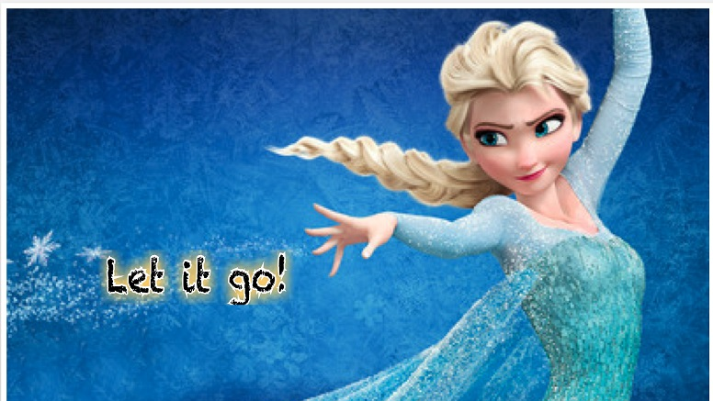

Slide 8


Slide 9


Slide 10
Prayer

