Slide 1
Silence

Slide 2
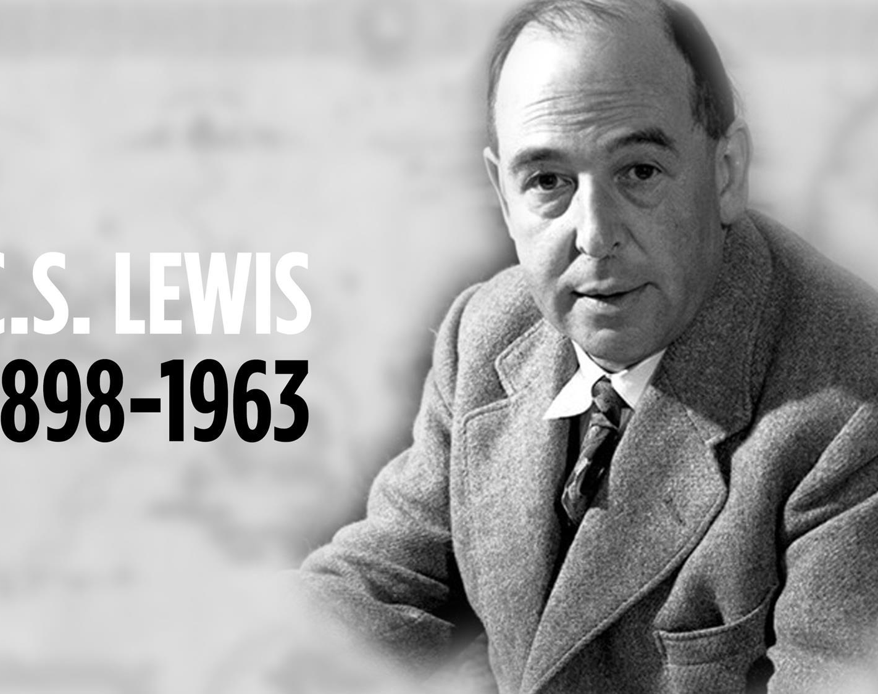
“We live, in fact, in a world starved for solitude, silence and privacy and therefore starved for medidation and true friendships”
CS LEWIS

Slide 3
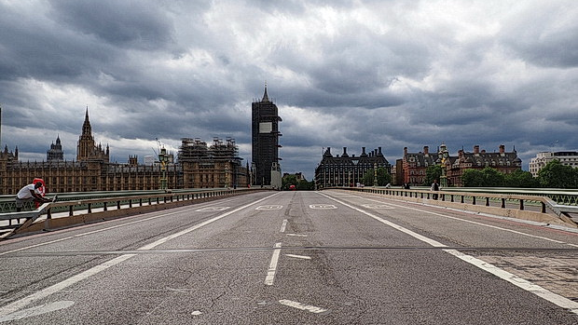

Slide 4
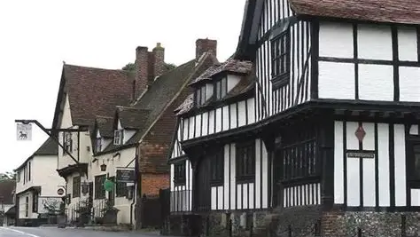

Slide 5


Slide 6
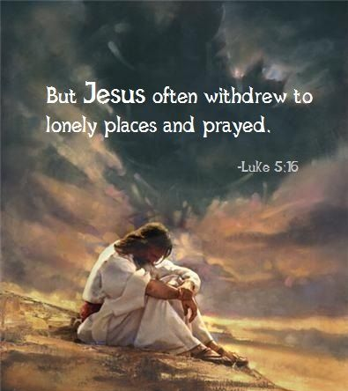

Slide 7

A PLACE TO BE SEEN AND RECEIVE

Slide 8
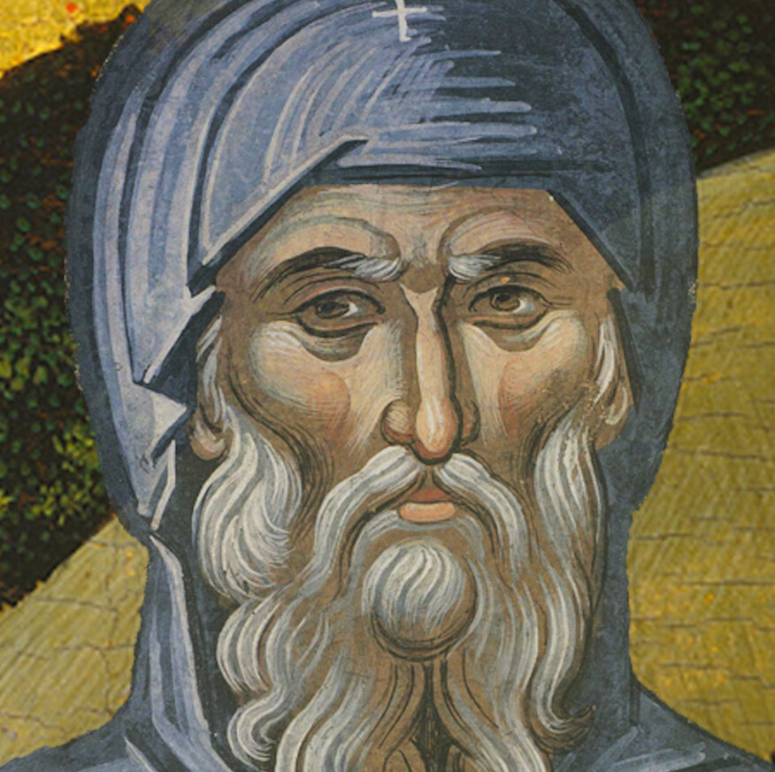
ST ANTHONY

Slide 9


Slide 10
PRAYER
LORD, IN A WORLD OF HURRY AND HASTE, HELP ME TO STILL MY SOUL, QUIET MY MIND AND DIRECT MY HEART TOWARDS YOU. IN SILENCE I REMEMBER THAT YOU ARE GOD, AND THIS CHANGES EVERYTHING. TEACH ME THE UNFORCED, UNHURRIED RHYTHMNS OF YOUR GRACE.
AMEN

