Slide 1
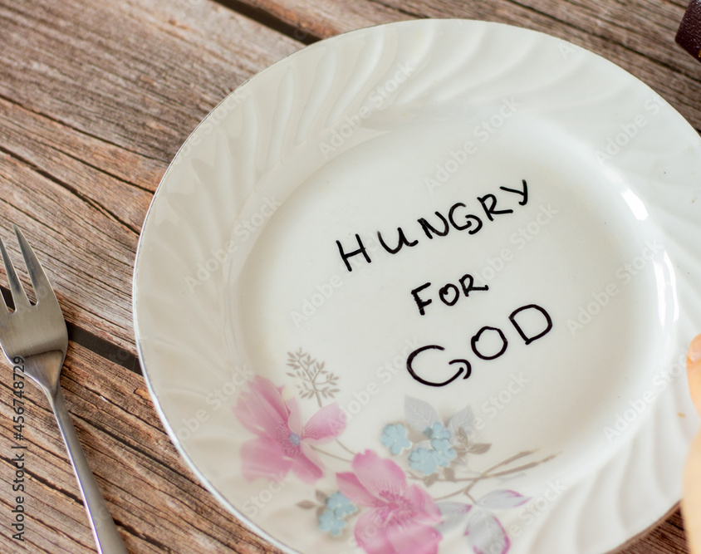
Hunger for Holiness

Slide 2
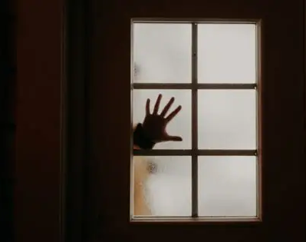
Sin is crouching at your door; it desires to have you, but you must rule over it.

Slide 3
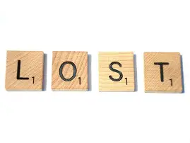
It is better to lose than to be lost

Slide 4

Passion for Holiness

Slide 5

Good News
Romans 3:23
Romans 6:23
Hebrews 4:15
1 Peter 2:24
1 Corinthians 15:3-4
Ephesians 2:8-9
Acts 2:38
Romans 10:9–10
2 Corinthians 5:17–19
John3:16

Slide 6
Active Against Sin
Hebrews 12:1
Matthew18:9
James 4:7
Colossians 3:5
Corinthians 6:18

Slide 7

Cassian’s Eight Thoughts
` Gluttony
` Lust
` Greed (or love of money)
` Anger
` Dejection
` Acedia (which means apathy or listlessness)
` Vainglory (which means boasting or showing off)
` Pride

Slide 8
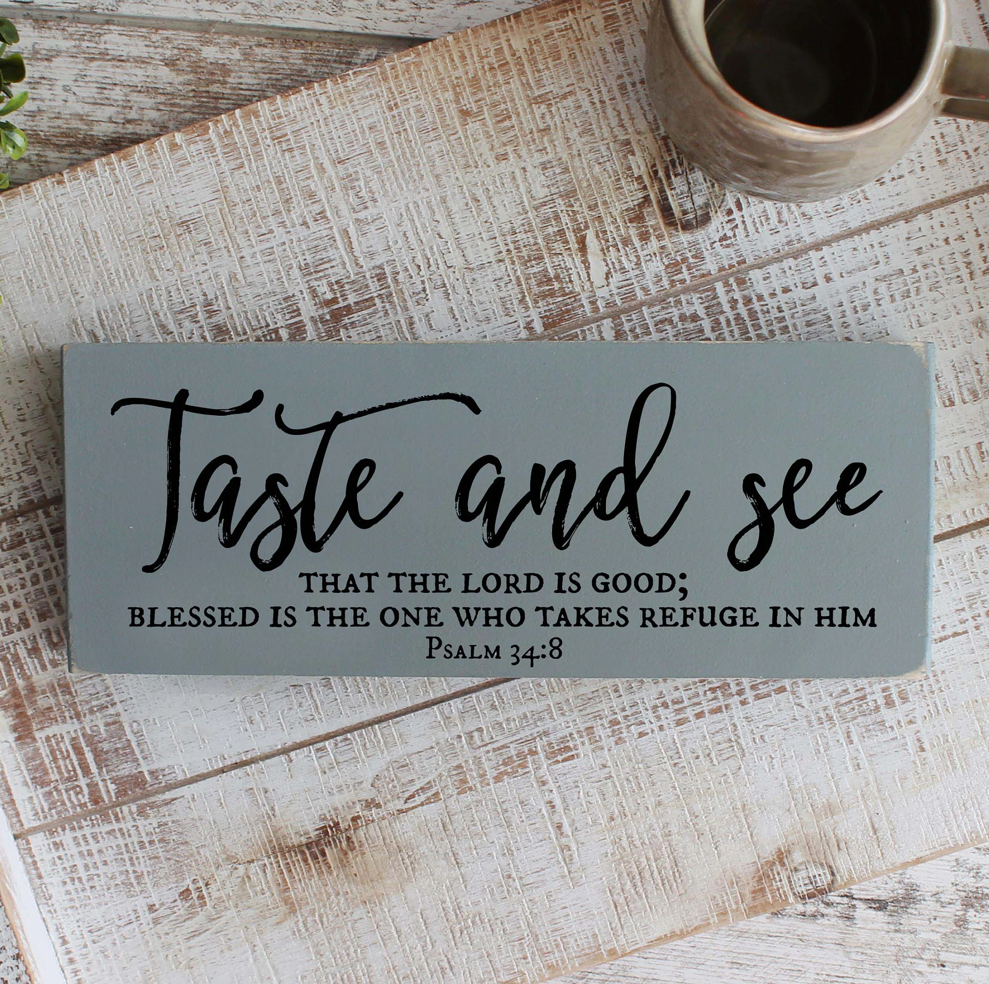
‘So why not behold God, look to Him, turn all your ache and desire toward his goodness and let Him have it?’

Slide 9

Prayer

