Slide 1


Slide 2
Led By the Spirit
Through Obedience
Without Reward

Slide 3
Chosen Separation
Led into Temptation
Devoted to the Lord

Slide 4

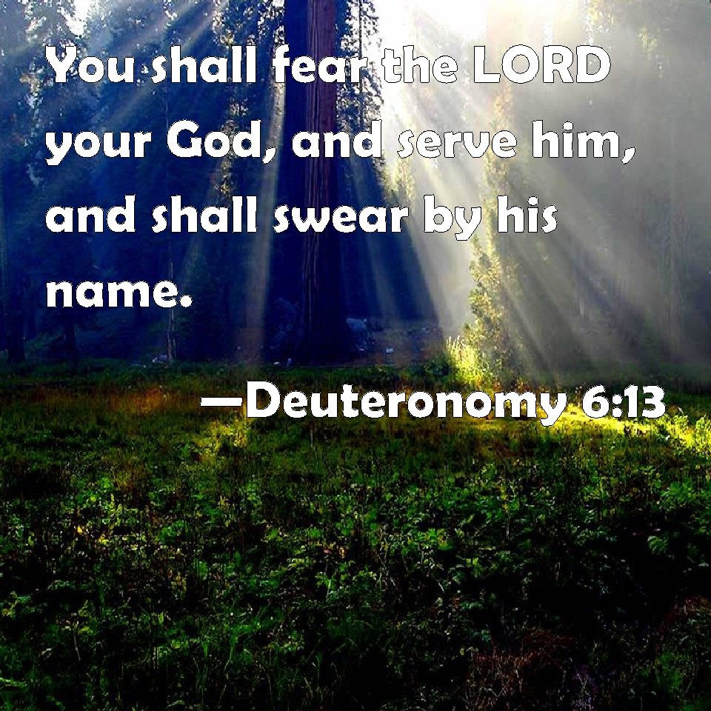
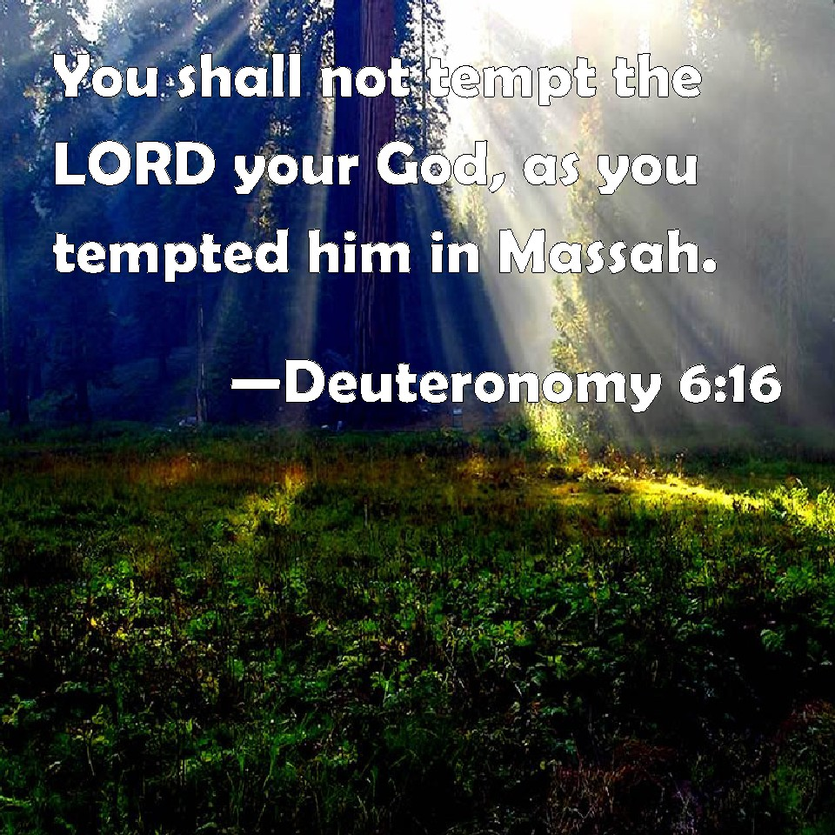
A SHOULD DO KIND OF DEVOTION

Slide 5
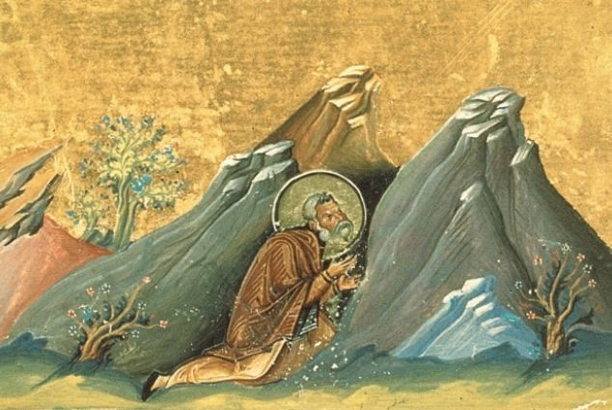
“their lives became a potent, prophetic challenge to the depravity of contemporary society and the compromises of the Church.”

Slide 6


Slide 7
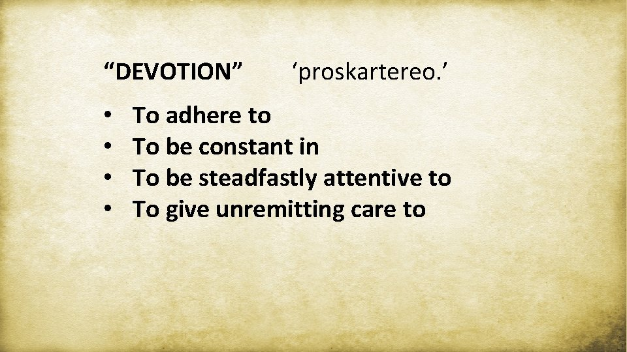

Slide 8


Slide 9


