Slide 1
Great Lessons – Great Lives
1. From the pit to the palace: Joseph - Dayo
2. Courage for such a time: Esther - Frank
3. A heart after God: David - Luke
4. A bold stand: Daniel - Dayo

Slide 2
WHY THIS SERIES?
1. Everyday of our lives, “We have never been this way before” Jos. 3:4.
2. For everything that was written in the past was written to teach us, to endure and be encouraged. Rom. 15:4.
3. In so far we want to live godly life in Christ, we would be persecuted. 2 Tim. 3:12.

Slide 3
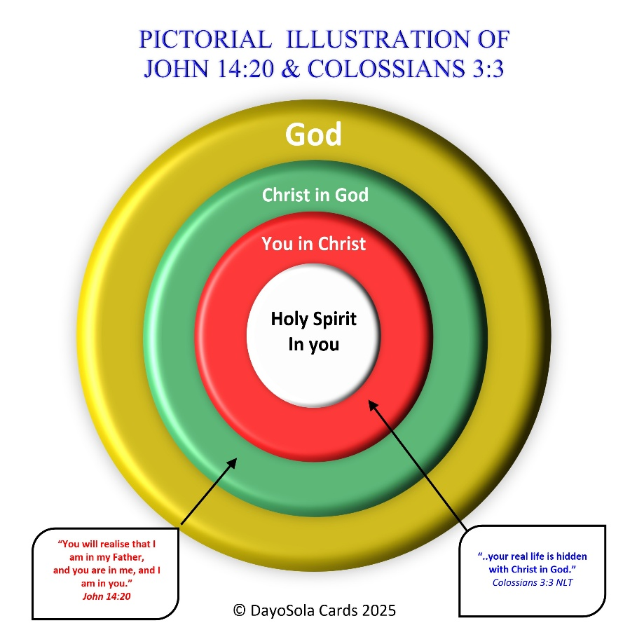
Whatever happens, wherever you are:
You are triple insulated or cushioned by God.
You are safe.

Slide 4
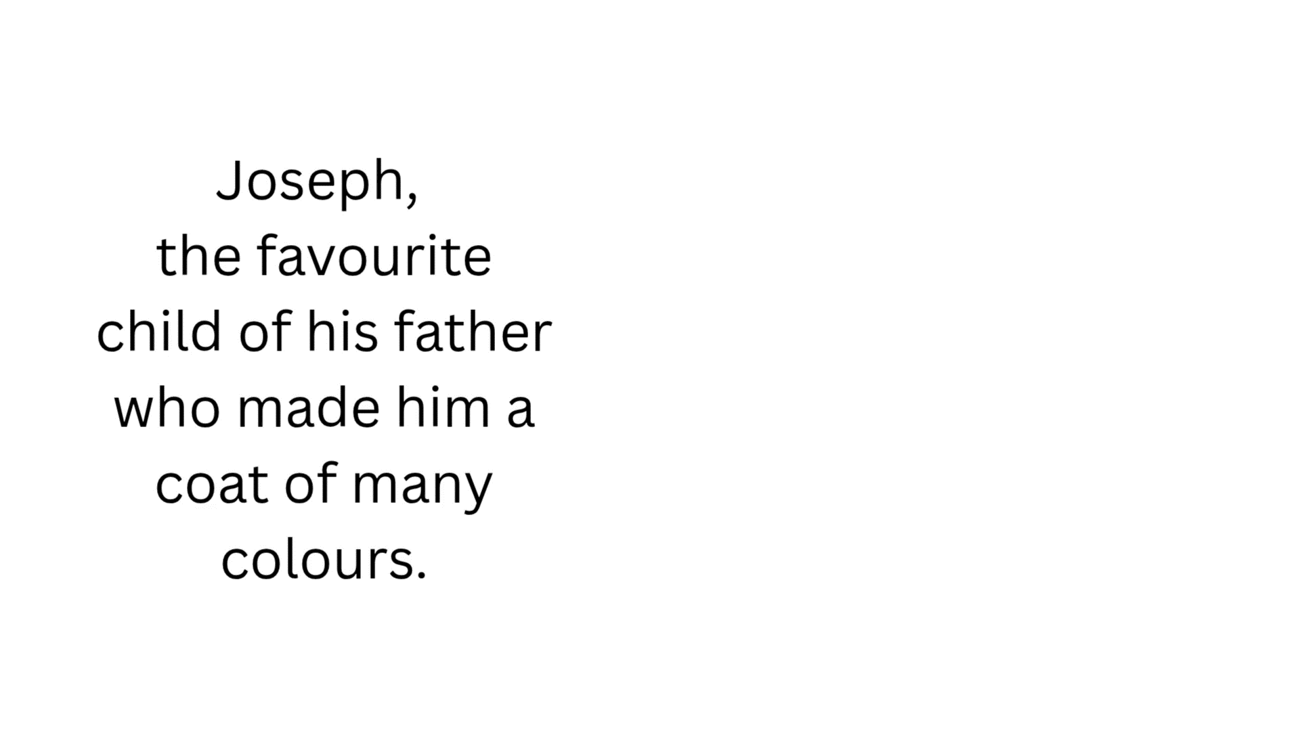
AI generated image

Slide 5
The Pit: When life knocks you down 37:23-24
God’s purpose is unstoppable even in your lowest.
You may be hard pressed – you will not be crushed.
Perplexed – you will not be in despair.
Persecuted, He will not abandon you.
Struck down, you will not be destroyed 2 Cor. 4:8-9.

Slide 6
2. The Prison: When faithfulness is tested
Gen. 39-40
Temptations will come in subtle and convenient ways – lust of the flesh, lust of the eyes and pride of life 1 John 2:16
Know who you are in Christ.
Know what your God wants – no compromise.
Remain faithful to Him – don’t doubt Him.
Whoever touches you, touches the apple of His eyes – Zech. 2:8b – His promise for you.

Slide 7
3. The Palace – When God lifts you up (Gen. 41:39–41)
Whist in prison Joseph felt the pain of unjust sentence. Gen. 40:14-15.
But his palace moment came:
Suddenly - Pharaoh dreamt.
Unexpected - the butler remembered Joseph.
Unstoppable – Pharaoh summoned Joseph.

Slide 8
4. The Purpose – God meant it for good 50:15-21
Between the Pit and the Palace (Crucible of greatness), God turned Joseph from a spoilt and tale bearer child to a mature and big hearted man.
He developed him to be gracious, loving and forgiving person that kept no records of wrongs and saw the bigger picture - a type of Jesus.
He became a forgiving rather than revengeful person.
Joseph said to his brothers “You intended to harm me, but God intended it for good, to accomplish what is now being done, the saving of many lives.”

Slide 9
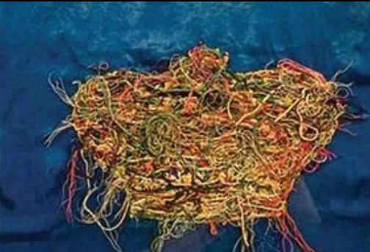
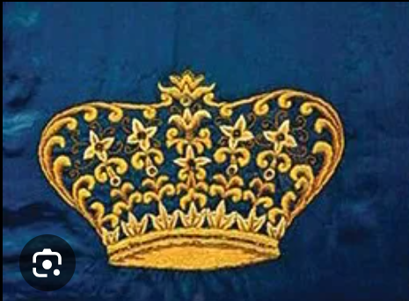
Tapestry: ugly & makes no sense
When God is working on us.
Reverse side: beautiful that makes sense.
After God completes His work and always on the hind sight.

Slide 10
5. Practical Applications:
Stay faithful in the Pit.
Don’t yield to temptations, they will surely come.
Keep your integrity in prison.
Trust God’s timing for the Palace time.
Forgive whoever and whatever.
Embrace God’s bigger purpose.

Slide 11
Signs of total forgiveness: when
It does not hurt you anymore when you see or remember those who hurt you.
You don’t tell everyone, cover their skeleton.
You do not let them be afraid of you, embrace them.
You don’t rob it in on them, let them safe face.
You pray for them and ask God to bless them.

Slide 12
CONCLUSION:
Your pit is not your ending, don’t despise it.
Your prison is not your destiny, don’t lose hope in it
God is writing a beautiful story for your Palace.
The same God who was with Joseph is also with you.
God’s purpose will be revealed and is unstoppable.

Slide 13
FINAL WORD:
IN WHATEVER SITUATION YOU ARE
IF GOD BRINGS YOU TO IT,
HE WILL BRING YOU THROUGH IT.
SO IN:
HAPPY MOMENT, PRAISE GOD.
DIFFICULT MOMENT, SEEK GOD.
QUIET MOMENT, WORSHIP GOD.
PAINFUL MOMENT, TRUST GOD.
EVERY MOMENT, THANK GOD.

Slide 14
PRAYER:
Dear Lord, thank You for forgiving my many sins.
I come clean before you that I struggle to forgive others.

Slide 15
I ask that You will help me overcome this unforgiveness that chains me.

Slide 16
Help me forgive whoever have hurt me of whatever and I ask that You will bless them generously too.

Slide 17
Thank You for releasing me from my chains.
In Jesus name I pray.

